Slide 1
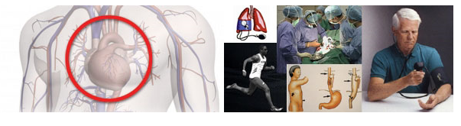
Ischemic Conditioning Therapy:
A New Path for Treatment of Endothelial Dysfunction and CVD
A Webinar Presentation on December 8th, 2016 2PM PST

Slide 2
Robert A. Kloner MD, PhD
Director of the Cardiovascular Research Institute of HMRI
VP of Translation, HMRI
Professor of Clinical Medicine, Division of Cardiovascular Medicine, Dept. of Medicine,
Keck School of Medicine at University of Southern California
Disclosure: Dr. Kloner is a consultant to IC Therapeutics and Endothelin, Inc.

Slide 3
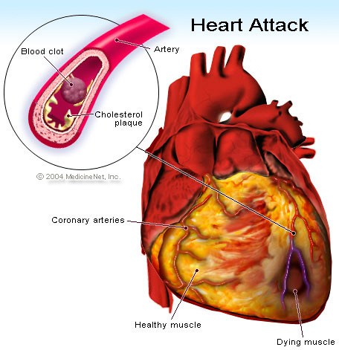

Slide 4
Myocardial Infarction (Heart Attack)
In the US there are close to 1 million myocardial infarctions (MI) annually.
Despite improved survival rates with early reperfusion therapy (thrombolytics, angioplasty, stenting), there is still a 1 month mortality rate of ~10% and a one year mortality rate of ~13%.
Congestive heart failure remains a significant morbidity (~25% in 1yr post-MI).

Slide 5
A recent study in the NEJM showed that although the time from ambulance arrival to reopening the occluded artery in a catheterization laboratory has shortened in the US (~90 min), further shortening of time has not improved mortality (1).
Better interventions are needed.
Heart attack size correlates with mortality and heart failure. Even a 5% reduction in size improves clinical outcome (2,3).
Menees DS et al. NEJM 2013;369:901-909.
Boden H et al. Am J Cardiol 2013;111:1387-93.
Turer AT et al. Curr Control Trials Cardiovasc Med. 2005 Aug 23;6:12.

Slide 6
Clinical Trials of MI Reduction
Many pharmacologic agents that were cardioprotective in animal models failed in clinical trials.

Slide 7
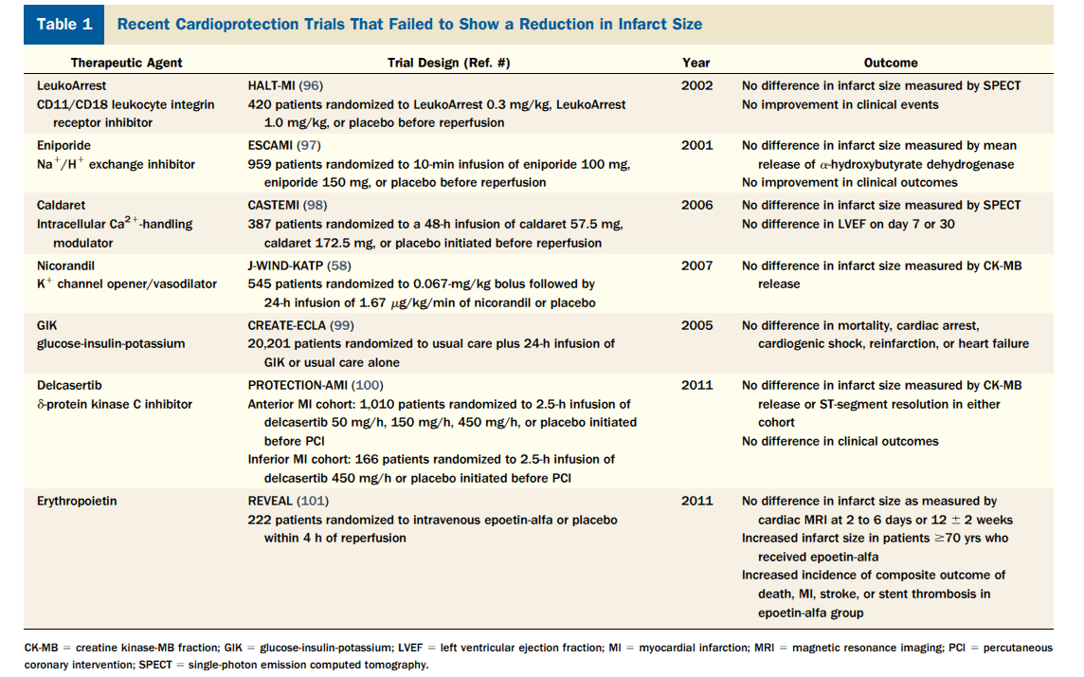
PZ Gerczuk and RA Kloner JACC 2012;59:969-78.

Slide 8
The Preconditioning Phenomenon
The heart’s own self-preserving mechanism
Brief periods of ischemia (2-5 minutes) prior to a longer duration of ischemia:
Reduce infarct size in most models
Reduce ventricular arrhythmias
If we can learn the mechanism of preconditioning, it may lead to potentially important therapies.

Slide 9
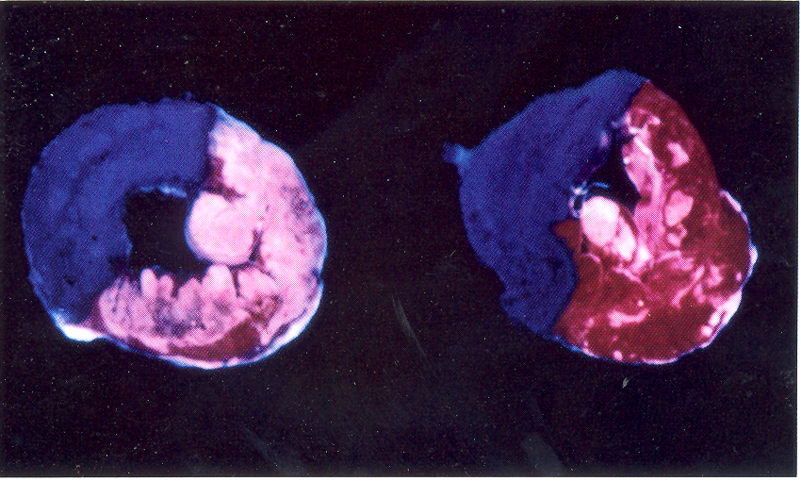
40 min occlusion plus 4 hours reperfusion in anesthetized rabbit;
Left = control;
Right = preconditioned with two 5 min occlusions plus 5 min reperfusion before the long occlusion.
Hale SL, Kloner RA Coronary Artery Disease 1992;3:133-140

Slide 10
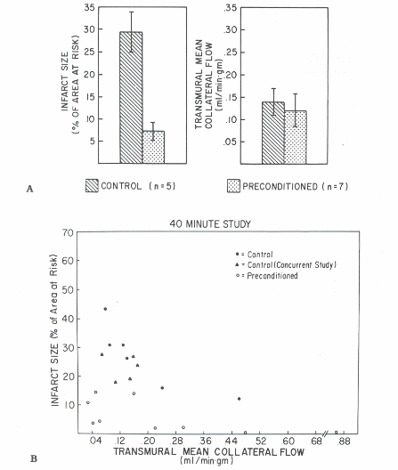
Effects of preconditioning on myocardial infarct size in dogs
Murry CE, Jennings RB, Reimer KA. Preconditioning with ischemia: a delay of
lethal cell injury in ischemic myocardium. Circulation. 1986 Nov;74(5):1124-36

Slide 11
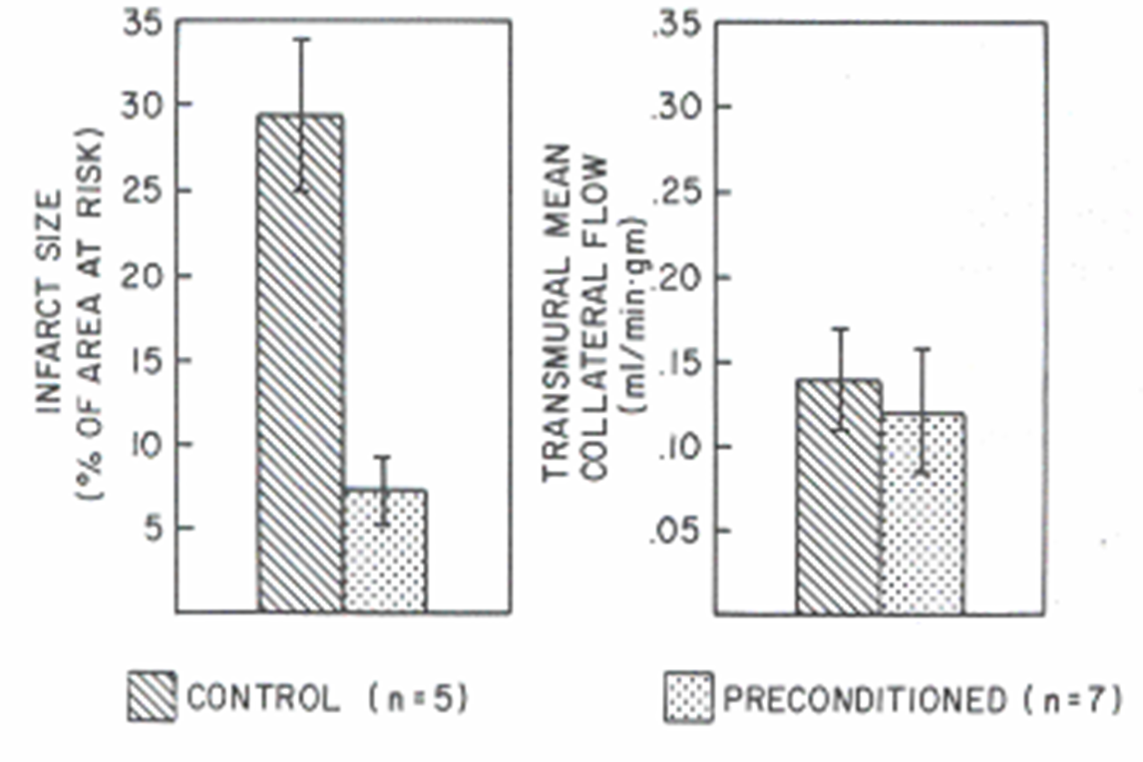
Murry CE, Jennings RB, Reimer KA. Preconditioning with ischemia: a delay of
lethal cell injury in ischemic myocardium. Circulation. 1986 Nov;74(5):1124-36

Slide 12
Clinical Evidence For Preconditioning
Less chest pain, ST-segment elevation, lactate production with subsequent compared to first angioplasty balloon inflation
Reduction in infarct size, mortality and CHF in patients with history of angina before acute MI
Acute tolerance to angina (warm up phenomenon)
Studies performed on human cardiac tissue:
  ATP levels during CABG
  In vitro studies on isolated human muscle
  In vitro studies on human myocytes

Slide 13
Kloner RA, Shook T, Przyklenk K, Davis VG, Junio L, Matthews RV, Burstein S,
Gibson M, Poole WK, Cannon CP, McCabe C, Braunwald E, for the TIMI 4 Investigators. Previous angina alters in-hospital outcome in TIMI 4. A clinical correlate to preconditioning? Circulation 1995; 91:37-45.

Slide 14
Kloner RA, Shook T, Przyklenk K, Davis VG, Junio L, Matthews RV, Burstein S,
Gibson M, Poole WK, Cannon CP, McCabe C, Braunwald E, for the TIMI 4 Investigators. Previous angina alters in-hospital outcome in TIMI 4. A clinical correlate to preconditioning? Circulation 1995; 91:37-45.

Slide 15
Remote Ischemic Preconditioning or Ischemic Conditioning at a Distance
Ischemic conditioning of one vascular bed may protect a remote vascular bed. This could occur within the same organ or between different organs.

Slide 16
Regional ischemic preconditioning protects remote virgin myocardium from subsequent sustained coronary occlusion
In this study, preconditioning the circumflex coronary artery bed reduced infarct size when the left anterior descending artery was occluded for 60 min followed by reperfusion.
Showed that “Brief episodes of ischemia in one vascular bed protect remote, virgin myocardium from subsequent sustained coronary artery occlusion in canine model.”
Przyklenk K, Bauer B, Ovize M, Kloner RA, Whittaker P. Regional ischemic 'preconditioning' protects remote virgin myocardium from subsequent sustained coronary occlusion. Circulation. 1993 Mar;87(3):893-9

Slide 17
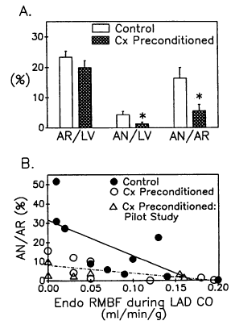
Regional ischemic preconditioning protects remote virgin myocardium
Przyklenk K. et al. Circulation 1993;87:893

Slide 18
Ischemic preconditioning at a distance. Reduction of myocardial infarct size by partial reduction of blood supply combined with rapid stimulation of the gastrocnemius muscle in rabbit.
Birnbaum Y, Hale SL, Kloner RA. Ischemic preconditioning at a distance: reduction of myocardial infarct size by partial reduction of blood supply combined with rapid stimulation of the gastrocnemius muscle in the rabbit. Circulation. 1997 Sep 2;96(5):1641-6.
Showed that remote ischemia of a skeletal muscle could precondition the myocardium.

Slide 19
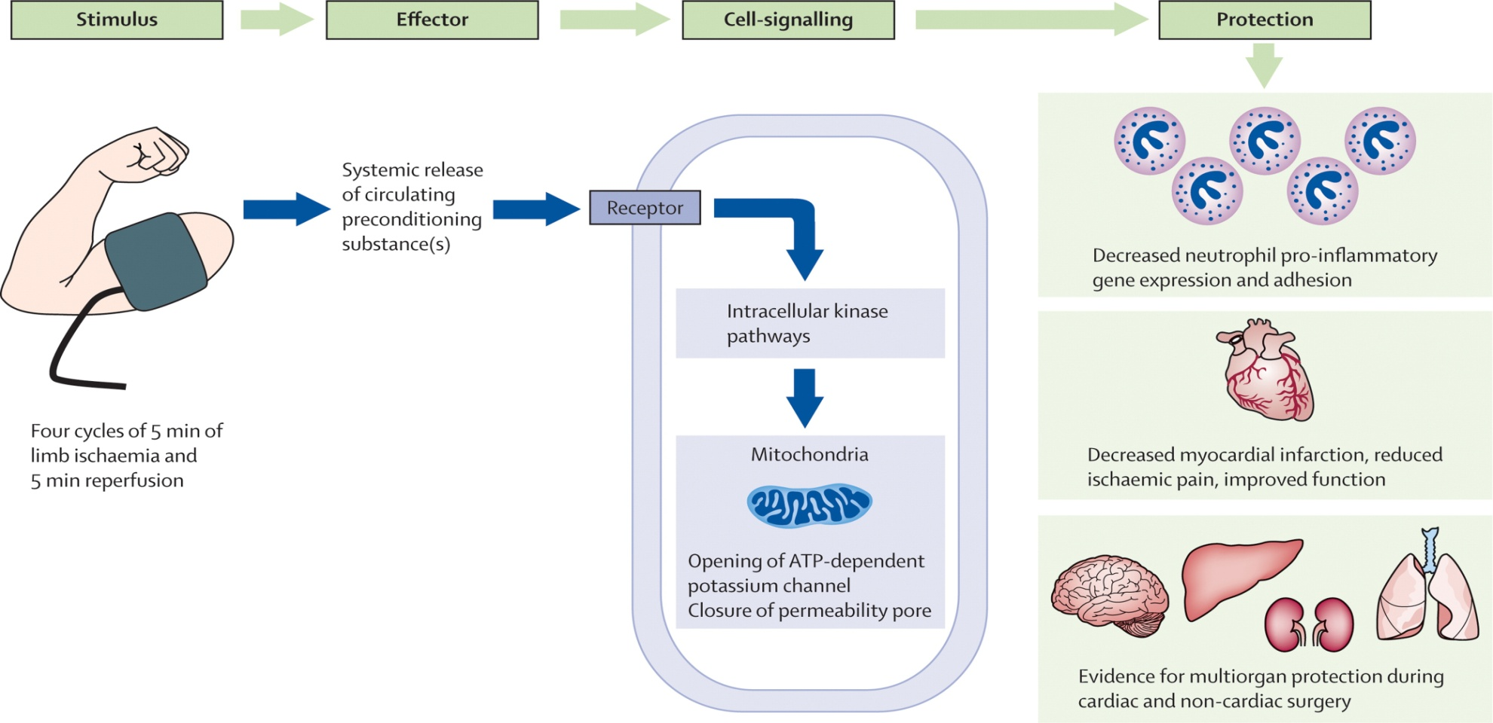
Mechanisms
Stimulus
Effector
Cell-signaling
Protection
4 cycles of
5 min. I
5 min. R
Ischemic tissue releases
“drug cocktail”

Slide 20
Remote ischaemic conditioning before hospital admission, as a complement to angioplasty, and effect on myocardial salvage in patients with acute myocardial infarction: a randomised trial
333 patients with first AMI randomized to primary PCI with or without remote conditioning (4 cycles of 5-minute brachial artery cuff inflation & 5 minutes deflation)
Median salvage index by myocardial perfusion imaging 0.75 in remote conditioning group versus 0.55 in control group, p = 0.03
Conclusion: Remote ischemic conditioning before hospital admission increases myocardial salvage and is safe.
Bøtker HE, et al. Remote ischaemic conditioning before hospital admission, as a complement to angioplasty, and effect on myocardial salvage in patients with acute myocardial infarction: a randomised trial. Lancet. 2010 375:727.

Slide 21
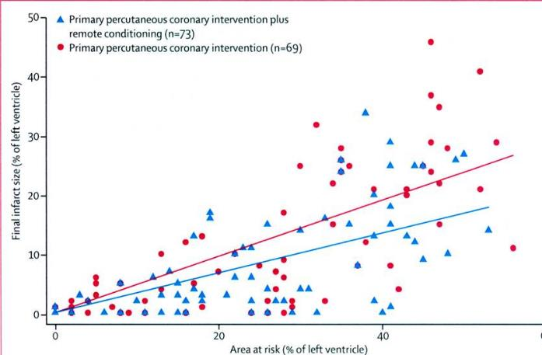
Bøtker HE, et al. Remote ischaemic conditioning before hospital admission, as a complement to angioplasty, and effect on myocardial salvage in patients with acute myocardial infarction: a randomised trial. Lancet. 2010 375:727.

Slide 22
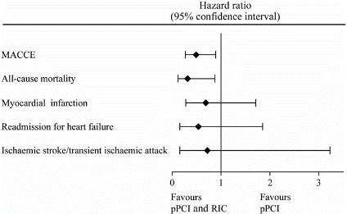
Improved long-term clinical outcomes in patients with ST-elevation myocardial infarction undergoing remote ischaemic conditioning as an adjunct to primary percutaneous coronary intervention (The CONDI Study)
Sloth AD, et al, European Heart Journal (2014) 35, 168–175
333 pts with a first acute ST-elevation myocardial infarction were randomized to primary percutaneous coronary intervention with (n = 166) or without (n = 167) remote ischemic conditioning (intermittent arm ischemia through four cycles of 5-min inflation followed by 5-min deflation of a blood-pressure cuff
The primary endpoint was major adverse cardiac and cerebrovascular events (MACCE)—a composite of all-cause mortality, myocardial infarction, readmission for heart failure, and ischemic stroke/transient ischemic attack.
Hazard ratio for the primary composite endpoint and for the secondary endpoints in the follow-up period (median follow-up 3.8 yrs).

Slide 23
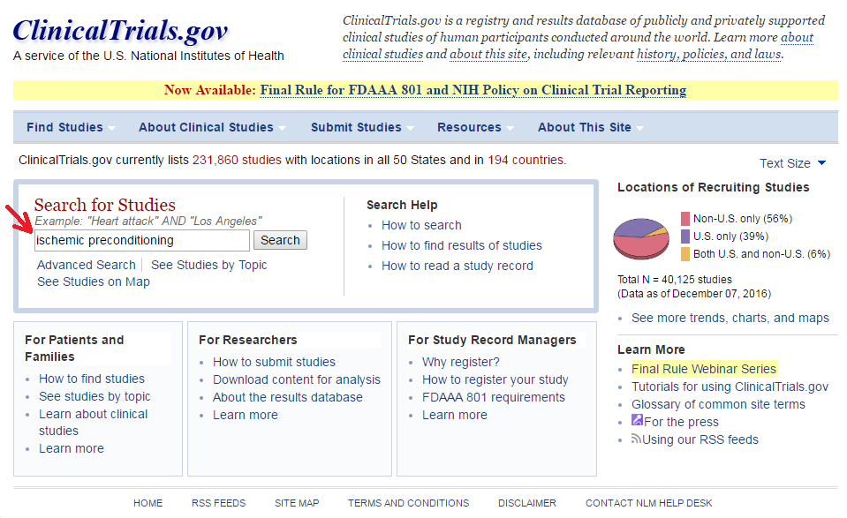

Slide 24
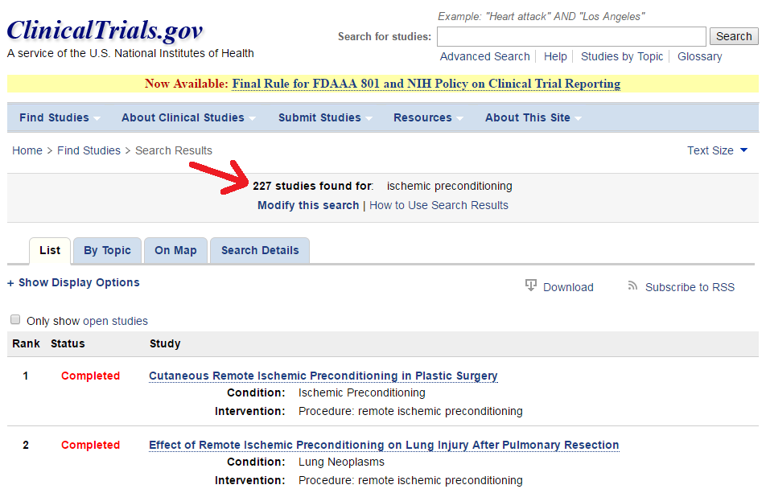

Slide 25
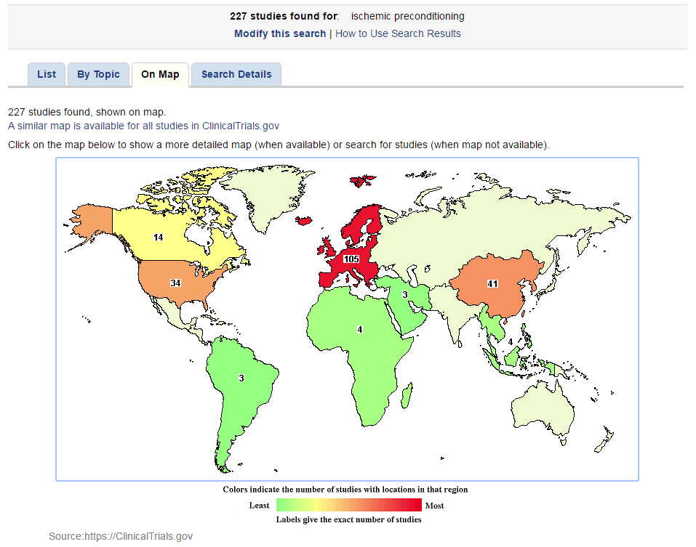

Slide 26
227 RIPC studies listed at ClinicalTrials.gov – accessed on 12/08/2016
These studies are aimed at investigating the use of RIPC for various conditions in addition to myocardial infarction, such as kidney transplantation, angiopathy in diabetes and intracranial atherosclerosis.

Slide 27
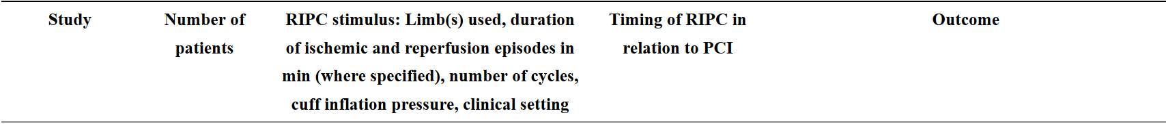
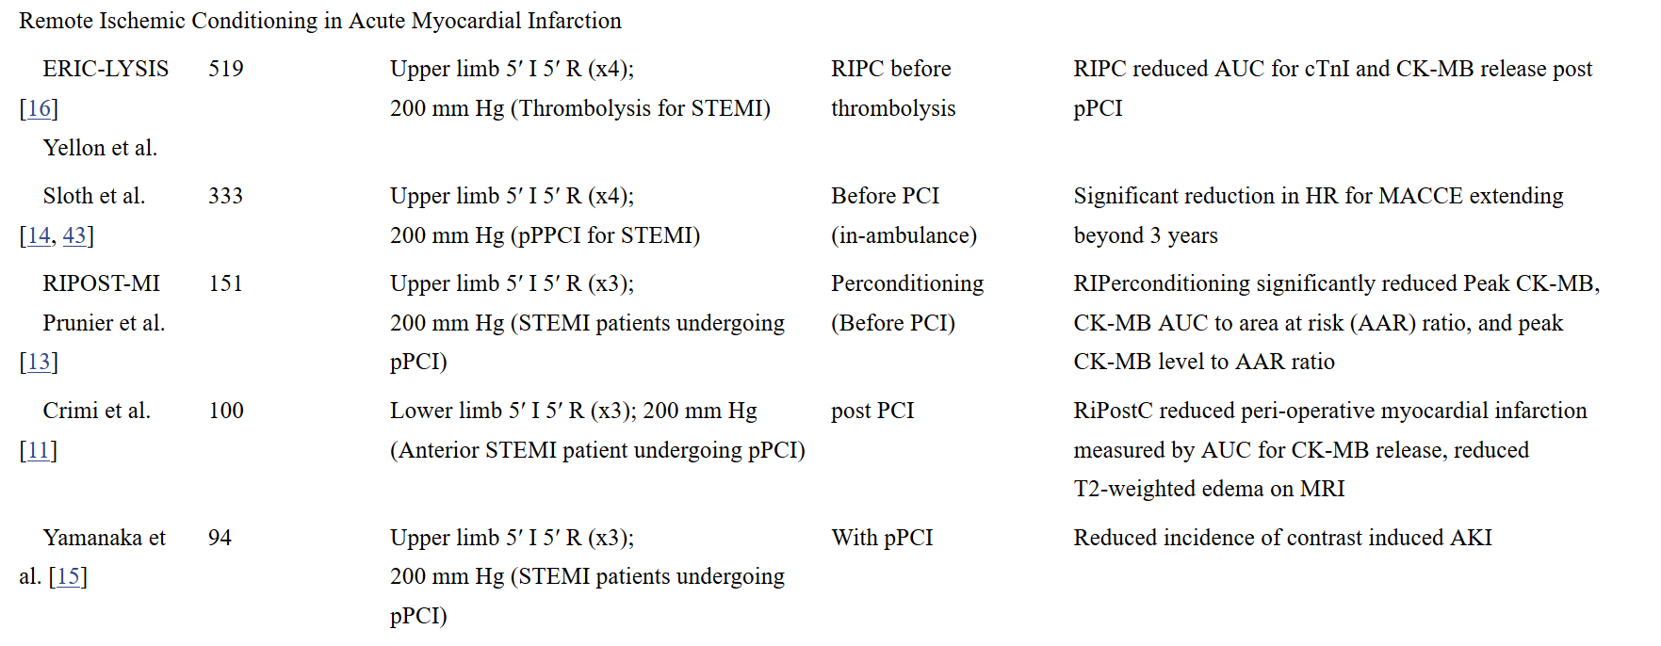
Remote Ischemic Conditioning in Acute Myocardial Infarction
Sharma et al., Cardiovasc Drugs Ther, 2015

Slide 28
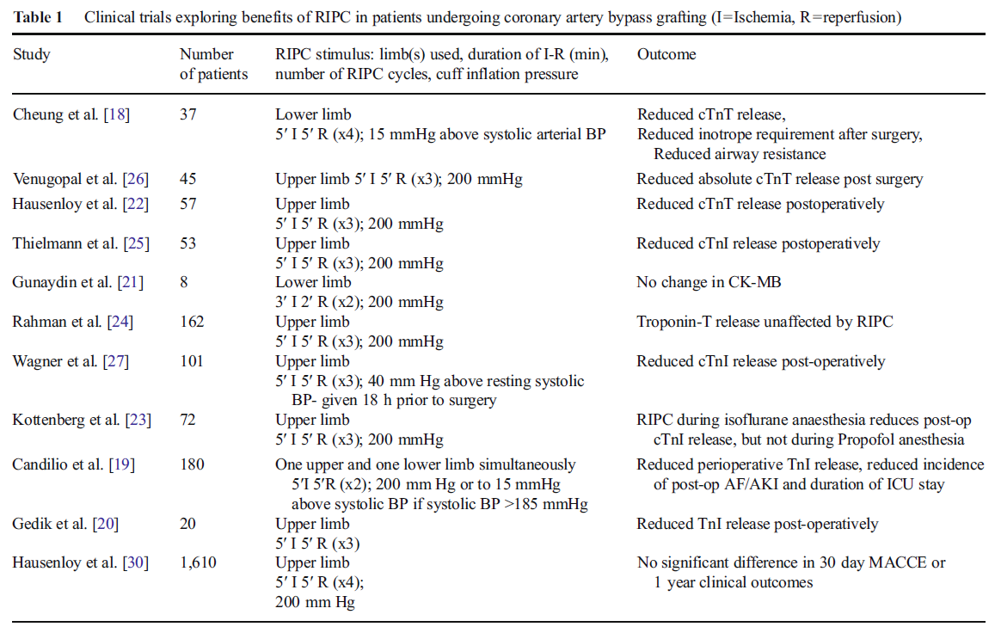
CABG
Sharma et al., Cardiovasc Drugs Ther, 2015

Slide 29
Meta-analysis of RIPC Cardioprotection Enzymes
Le Page et al., Basic Res Cardiol, 2015

Slide 30
Ischemic Conditioning-Potential Applications
Reducing myocardial infarct size
Reducing cardiac damage during percutaneous coronary intervention
Protecting the myocardium during coronary artery bypass grafting and other procedures requiring cardiopulmonary bypass
Protecting the vasculature during vascular surgery procedures
Unstable angina
Before activities that reproducibly cause angina in patients with stable angina
Protecting donor hearts before excision and transport
Protecting other organs (brain, kidney) during episodes of ischemia

Slide 31
Neurogenic pathway mediated remote preconditioning protects the brain from transient focal ischemic injury. Malhotra S, et al. Brain Res. 2011;1386:184-90.
Adult Wistar male rats underwent remote preconditioning (RIPC) or sham surgery
Then 2 hours middle cerebral artery occlusion (MCO)
Those having MCO 24 hours after RIPC had significantly smaller cerebral infarct volumes (150 mm3) versus controls (250 mm3; p<0.05) and better neurological scores
Ganglion blocker (hexamethonium) blocked the benefit

Slide 32
Upper limb ischemic preconditioning prevents recurrent stroke in intracranial arterial stenosis. Meng R, et al. Neurology. 2012;79(18):1853-61.
68 cases symptomatic atherosclerotic arterial stenosis (diagnosed by imaging)
Bilateral arm ischemic preconditioning (BAIPC, n=38) underwent
5 brief bilateral upper limb ischemia followed by reperfusion
Twice a day over 300 days
Incidence of recurrent stroke at 90 and 300 days were 23% and 26% respectively in untreated control group versus 5% and 7.9% respectively in preconditioning group (p < 0.01)
SPECT measure of cerebral flow improved in preconditioning group

Slide 33
Ischemic Conditioning Is Safe and Effective for Octo- and Nonagenarians in Stroke Prevention and Treatment. Meng R, et al. Neurotherapeutics. 2015;12(3):667-77.
Effectiveness of bilateral arm ischemic preconditioning (BAIPC) in reducing stroke recurrence in in octo- and nonagenarians patients
58 patients with symptomatic intracranial arterial stenosis randomized to BAIPC (5 cycles twice daily) versus sham for 180 days
BAIPC reduced hsCRP, IL-6, IL-1 and leukocyte count
At 180 days 2 infarctions and 7 TIAs in BAIPC group versus 8 infarctions and 11 TIAs in sham group (p < 0.05)

Slide 34
Remote ischemic perconditioning as an adjunct therapy to thrombolysis in patients with acute ischemic stroke: a randomized trial. Hougaard KD, et al. Stroke. 2014;45(1):159-67.
443 patients suspected acute stroke
Alteplase
MRI 24 hours, 1 months
Primary end point: penumbral salvage, volume of the perfusion-diffusion mismatch not progressing to infarction after 1 month
After adjustment for baseline perfusion and diffusion lesion severity, voxelwise analysis showed that remote conditioning reduced tissue risk of infarction (P=0.0003)

Slide 35
Remote ischemic postconditioning: Harnessing endogenous protection in a murine model of vascular cognitive impairment. Khan MB, Hoda MN, Vaibhav K, et al. Transl Stroke Res 2015; 6: 69-77
This group previously reported that remote ischemic conditioning during acute stroke confers neuroprotection (Hess DC et al. Stroke, 2013; 44: 1191-7) and increased cerebral blood flow (CBF).
They tested whether remote conditioning could augment CBF and prevent cognitive impairment in the BCAS (bilateral common carotid artery stenosis) mouse model.
BCAS was induced with customized micro coils in male mice to establish chronic cerebral hypoperfusion, which creates a model of vascular cognitive impairment.

Slide 36
One week after BCAS surgery mice treated with remote ischemic postconditioning once daily for 2 weeks.
Cognitive testing performed at 4 weeks.
RESULTS: Remote ischemic postconditioning improved cognitive function, inhibited inflammatory responses and prevented cell death, decreased accumulation of amyloid beta protein and protected white matter integrity.

Slide 37
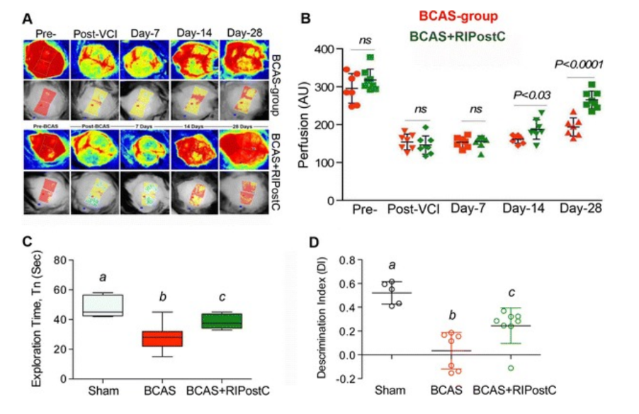
Khan MB, Hoda MN, Vaibhav K, et al. Transl Stroke Res 2015; 6: 69-77

Slide 38
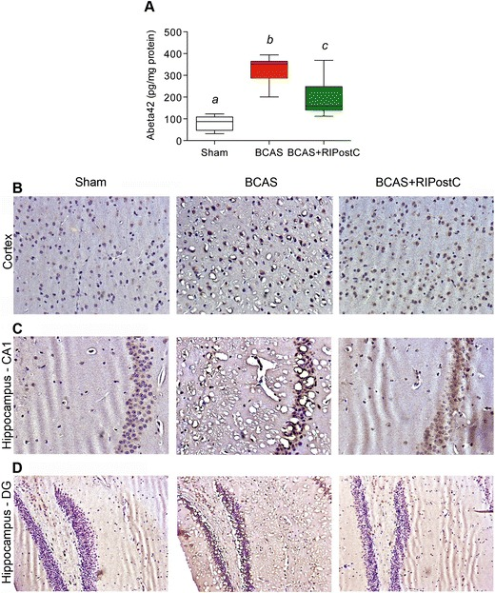
Khan MB, Hoda MN, Vaibhav K, et al. Transl Stroke Res 2015; 6: 69-77

Slide 39
