Slide 1
Ischemic Conditioning Therapy: A New Path for Treatment of Endothelial Dysfunction and CVD
Thursday, December 8, 2016, 2PM PST
Co-Presenter:
Morteza Naghavi, M.D. Chairman of Scientific Advisory Board

Slide 4
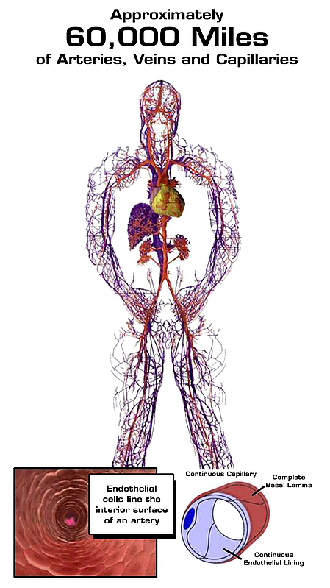
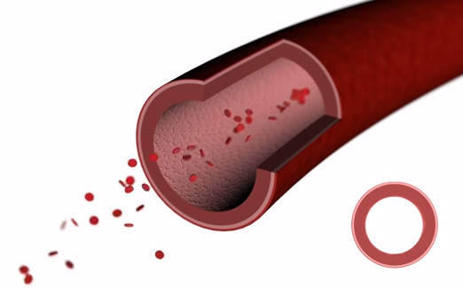
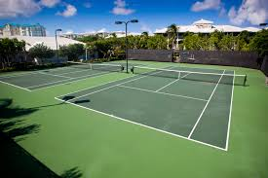
Surface area > 3 tennis courts!

Slide 6
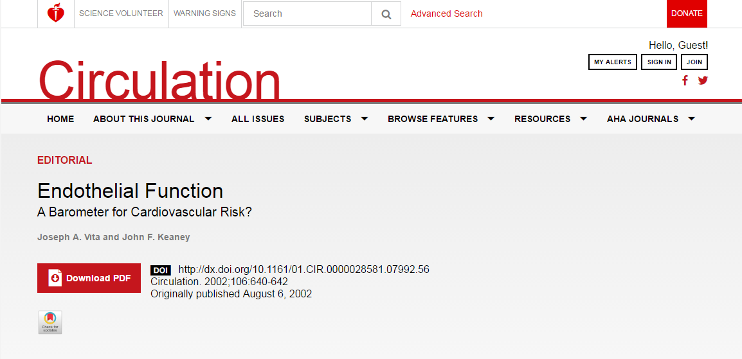
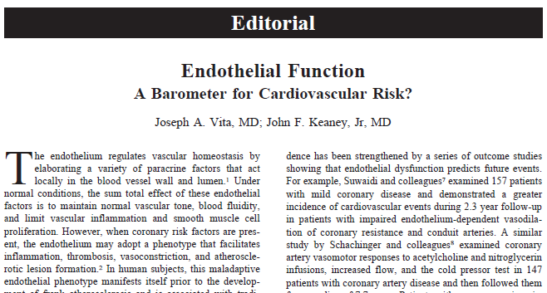

Slide 7
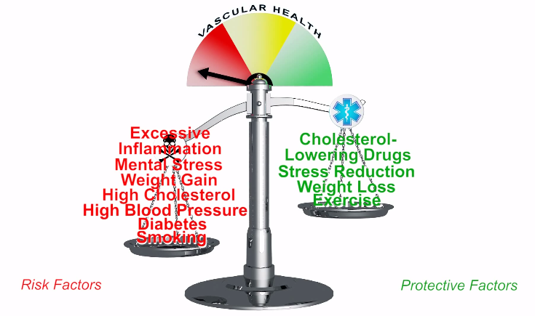

Slide 10
www.endothelix.com

Slide 11
What is VENDYS® technology?

Slide 12
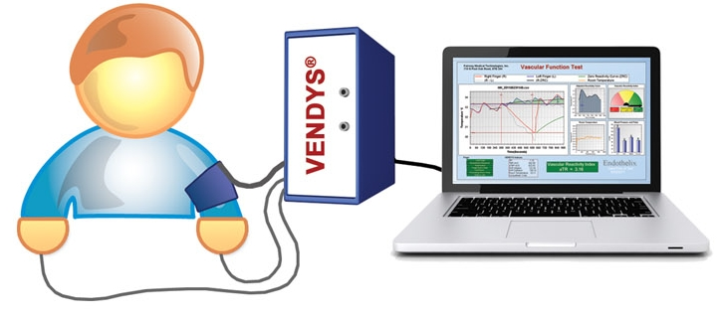
How does VENDYS® measure vascular function?

Slide 13
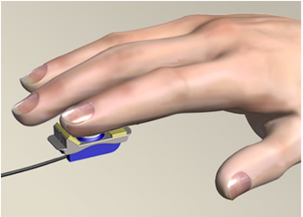
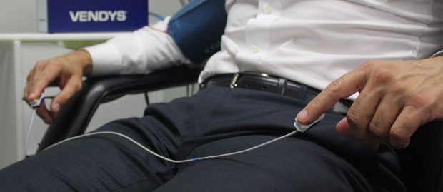
VENDYS® Vascular Function Monitoring
Blood Pressure “Occluding” Cuff on Right Upper Arm
Fingertip Temperature Sensors on Both Index Fingers

Slide 15
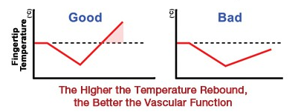
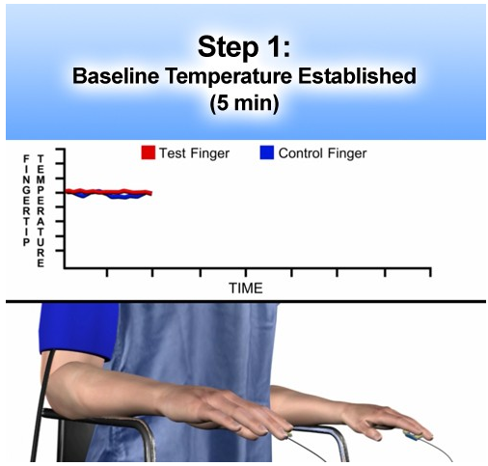
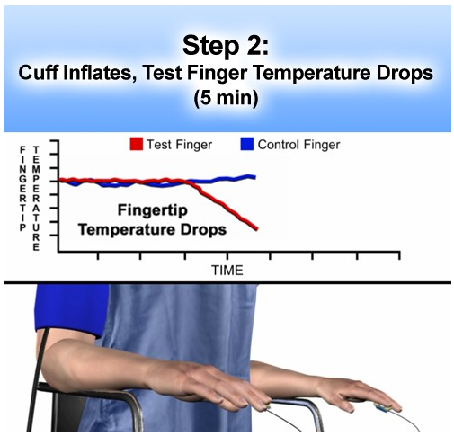
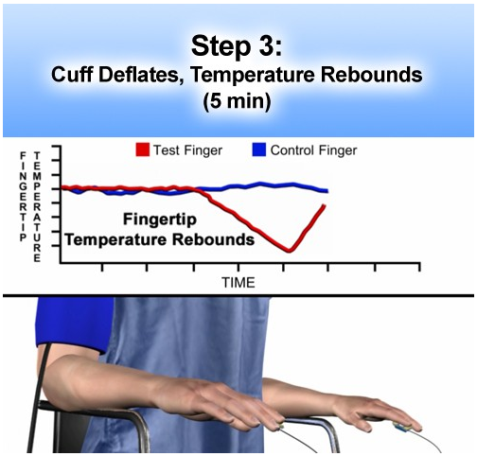
Vascular Function Monitoring

Slide 16
40 min occlusion plus 4 hours reperfusion in anesthetized rabbit; Left = control; Right = preconditioned with two 5 min occlusions plus 5 min reperfusion before the long occlusion. Hale SL, Kloner RA Coronary Artery Disease 1992;3:133-140

Slide 17
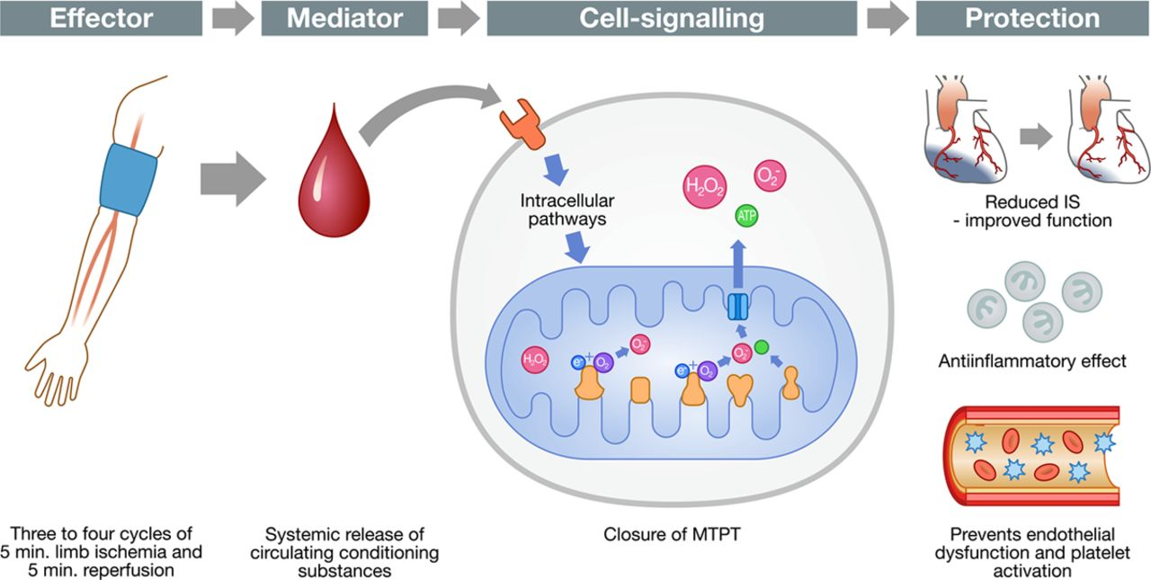
Michael Rahbek Schmidt, Steen Buus Kristiansen and Hans Erik Bøtker
Circulation Research. 2013;113:1278-1280

Slide 18
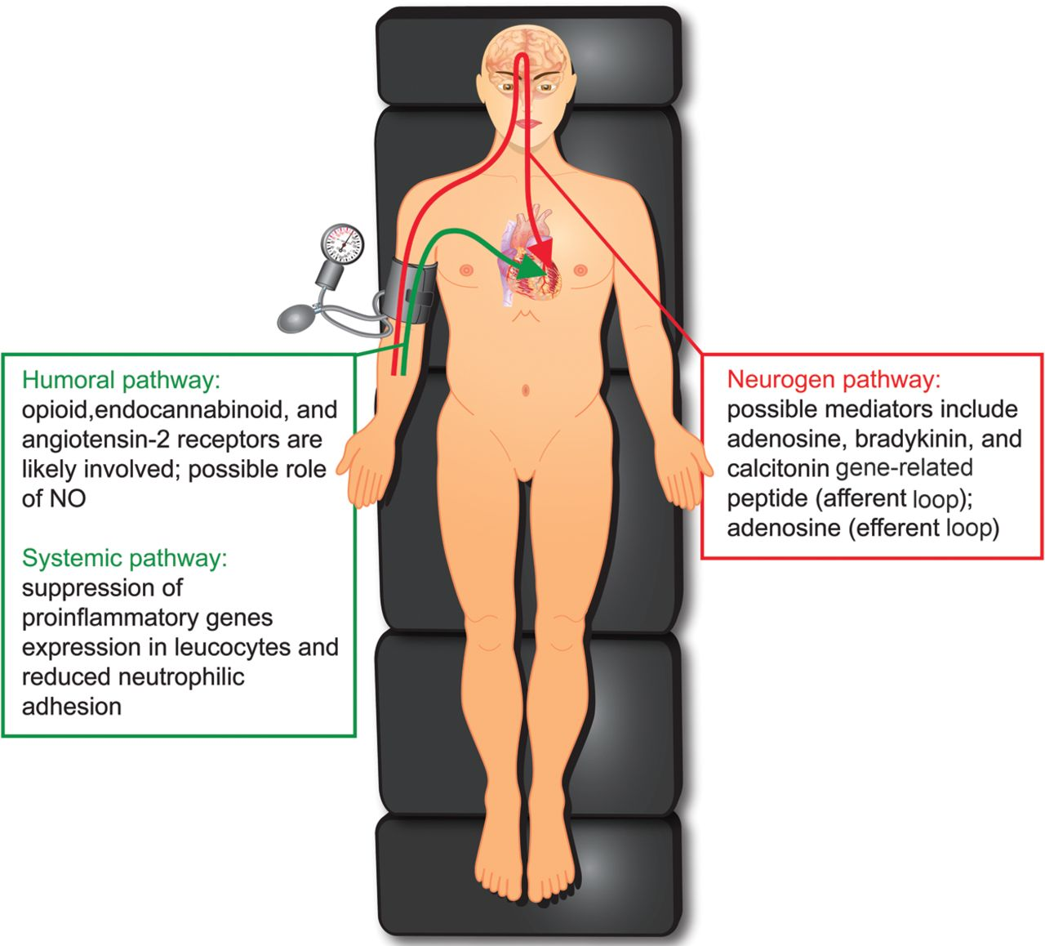
Philippe Kolh, M.D., Ph.D. Service de Cardiochirurgie, CHU Sart Tilman, B 35 Sart Tilman, Liege 4000, Belgium

Slide 19
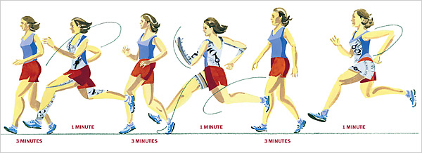
Exercise is a natural form of ischemic conditioning. In other words, ischemic conditioning is a medical form of exercise.

Slide 20
Arterioscler Thromb Vasc Biol. 2007 Jun;27(6)
Repetition of ischemic preconditioning
augments endothelium-pendent vasodilation
in humans: role of endothelium-derived
nitric oxide and endothelial progenitor cells.
Kimura M¹, Ueda K, Goto C, Jitsuiki D, Nishioka K, Umemura T, Noma K, Yoshizumi M, Chayama K, Higashi Y.
Department of Medicine and Molecular Science, Graduate School of Biomedical Sciences, Hiroshima University, 1-2-3 Kasumi, Mimami-ku, Hiroshima 734-8551, Japan.

Slide 21
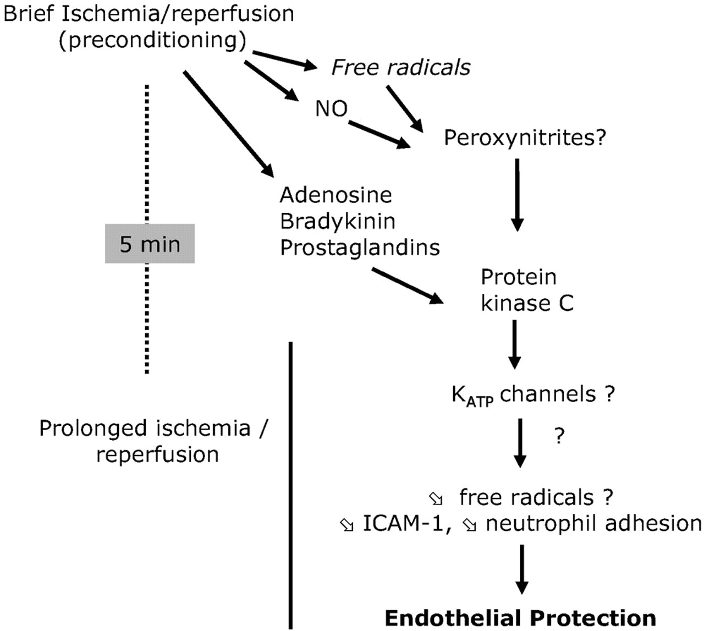

Slide 22
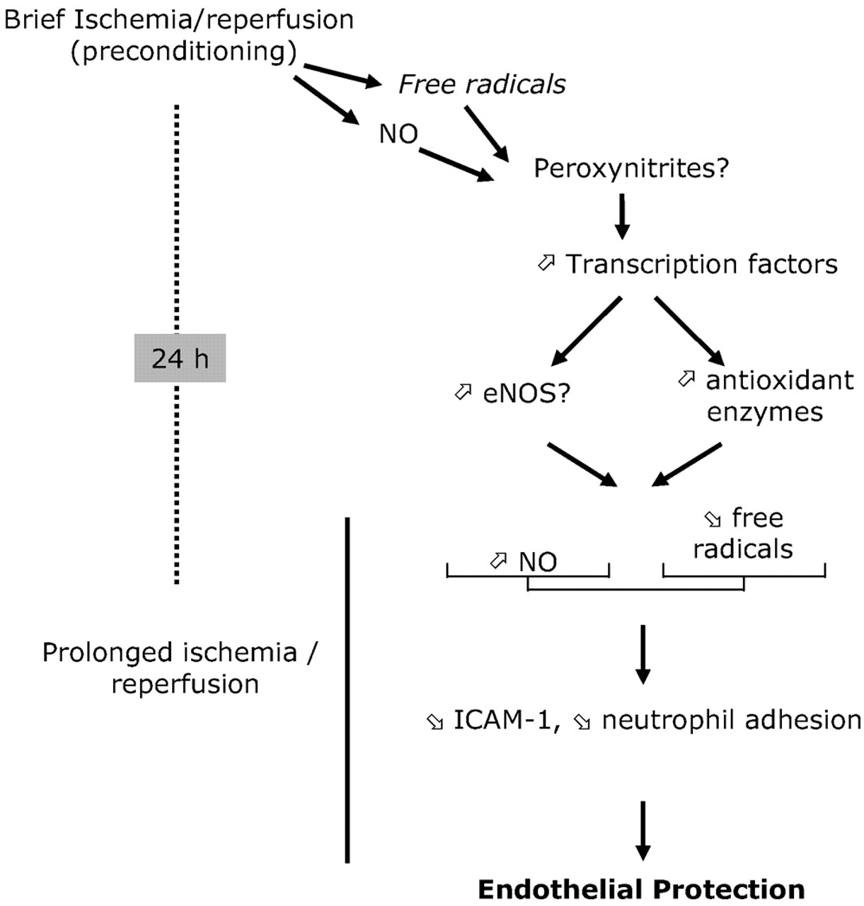

Slide 23
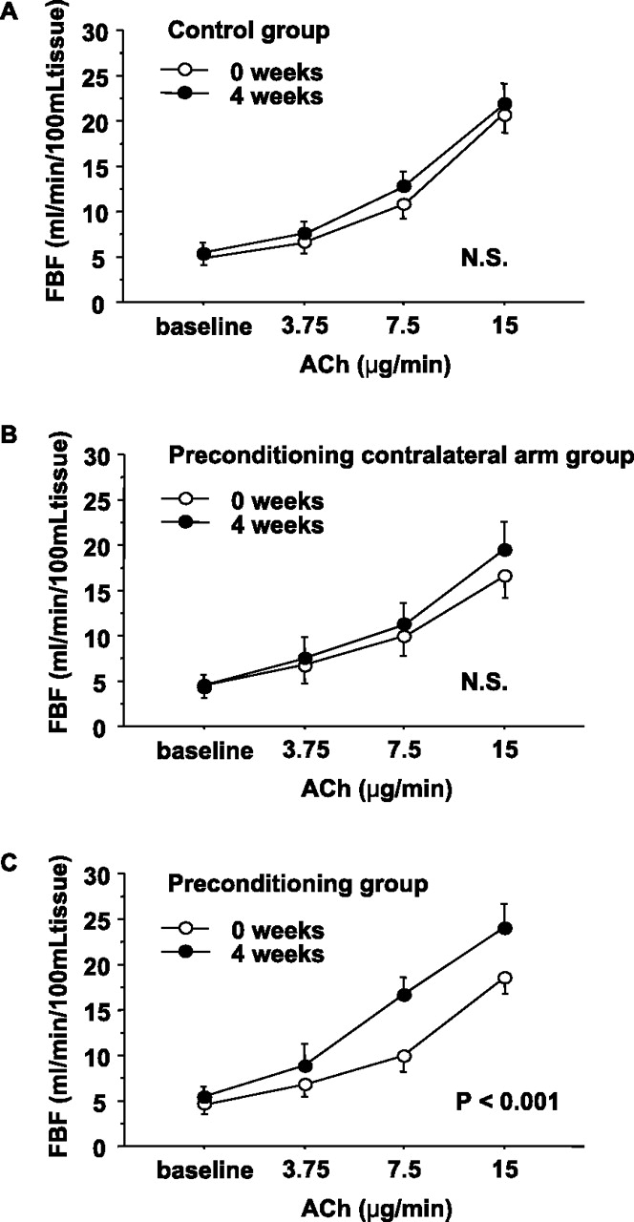
Figure 1. Comparison of forearm blood flow (FBF) responses to acetylcholine (ACh) at 0 weeks and 4 weeks of follow-up in the control group (A) and in the ischemic preconditioning untrained (contralateral) arm group (B) and ischemic preconditioning arm group (C).
Masashi Kimura et al. Arterioscler Thromb Vasc Biol. 2007;27:1403-1410
Notes:
Figure 1. Comparison of forearm blood flow (FBF) responses to acetylcholine (ACh) at 0 weeks and 4 weeks of follow-up in the control group (A) and in the ischemic preconditioning untrained (contralateral) arm group (B) and ischemic preconditioning arm group (C).

Slide 24
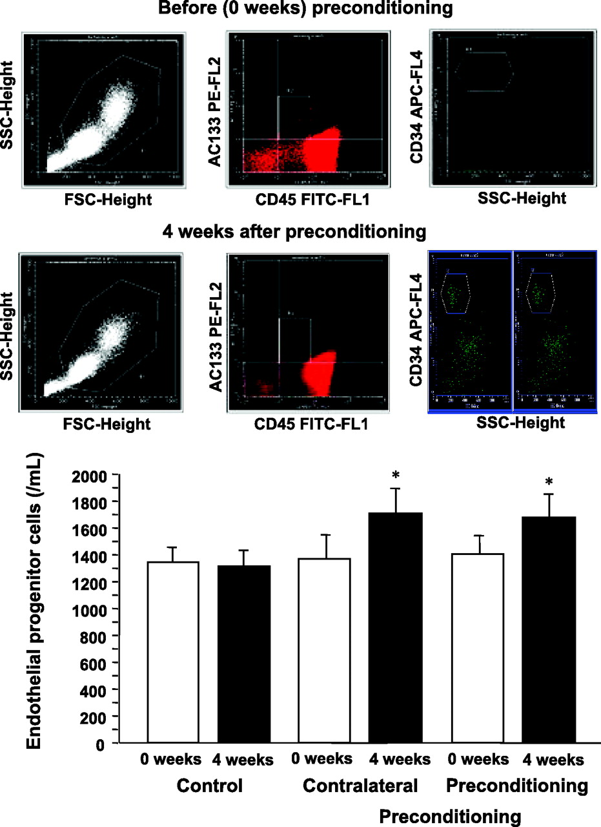
Figure 4. Measurement of the number of endothelial progenitor cells by flow cytometry at 0 weeks and 4 weeks of ischemic preconditioning stimuli (top).
Masashi Kimura et al. Arterioscler Thromb Vasc Biol. 2007;27:1403-1410
Notes:
Figure 4. Measurement of the number of endothelial progenitor cells by flow cytometry at 0 weeks and 4 weeks of ischemic preconditioning stimuli (top). Comparison of the number of endothelial progenitor cells at 0 weeks and 4 weeks of follow-up in the control group and in the ischemic preconditioning untrained (contralateral) arm group and ischemic preconditioning arm group. *P<0.05 vs 0 weeks in the preconditioning group.

Slide 25
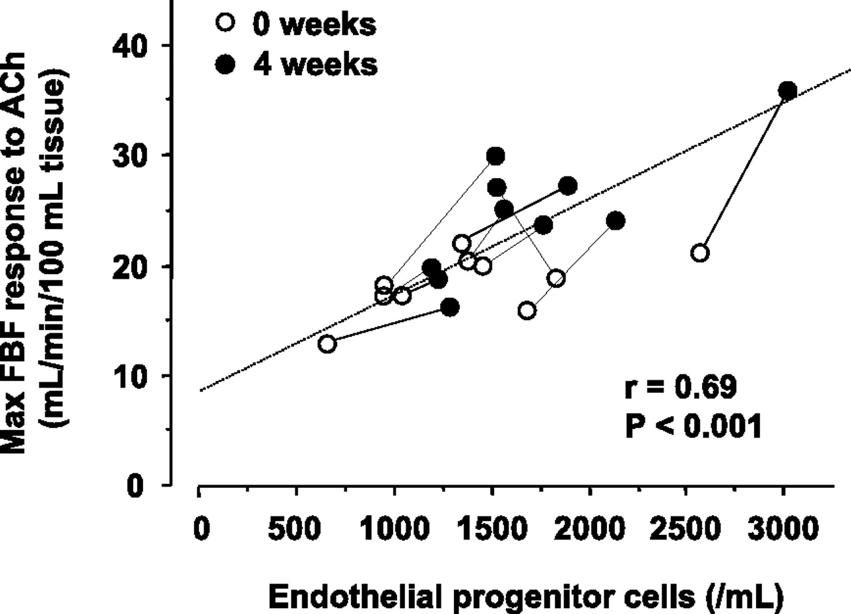
Figure 5. Correlation between maximal forearm blood flow (FBF) response to acetylcholine (ACh) and number of endothelial progenitor cells at 0 weeks and 4 weeks of ischemic preconditioning stimuli.
Masashi Kimura et al. Arterioscler Thromb Vasc Biol. 2007;27:1403-1410
Notes:
Figure 5. Correlation between maximal forearm blood flow (FBF) response to acetylcholine (ACh) and number of endothelial progenitor cells at 0 weeks and 4 weeks of ischemic preconditioning stimuli.

Slide 26
Atherosclerosis. 2011 Dec;219(2):750-2. doi: 10.1016/j.atherosclerosis.2011.08.046. Epub 2011 Sep 7.
Effect of local and remote ischemic preconditioning on endothelial function in young people and healthy or hypertensive elderly people.
Moro L, Pedone C, Mondì A, Nunziata E, Antonelli Incalzi R.
Area di Geriatria, Università Campus Biomedico, Roma, Italy.

Slide 27
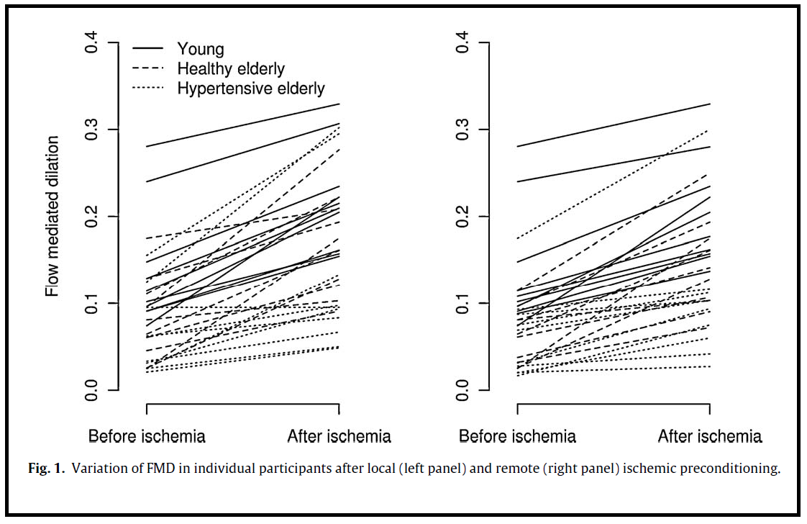
Moro L, Pedone C, Mondì A, Nunziata E, Antonelli Incalzi R.

Slide 28
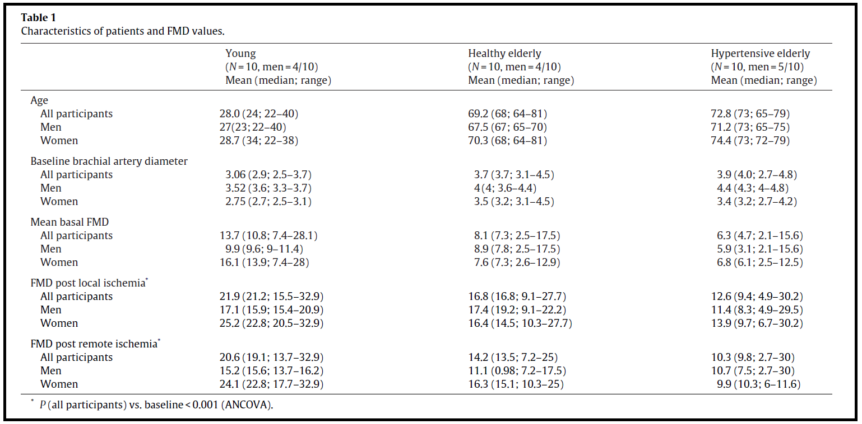
Moro L, Pedone C, Mondì A, Nunziata E, Antonelli Incalzi R.

Slide 29
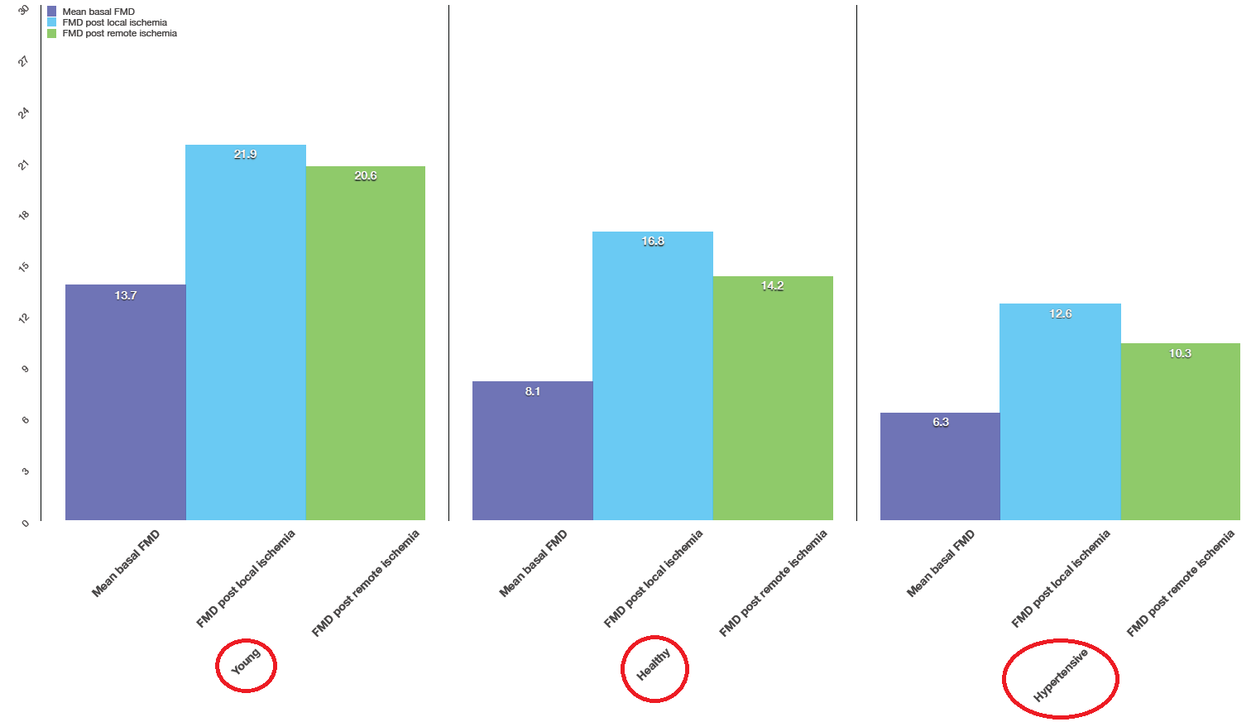

Slide 30
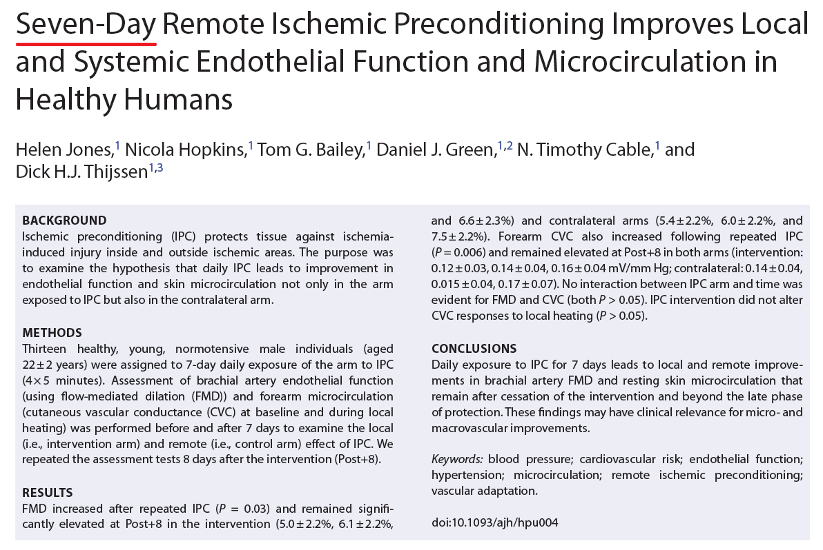

Slide 31
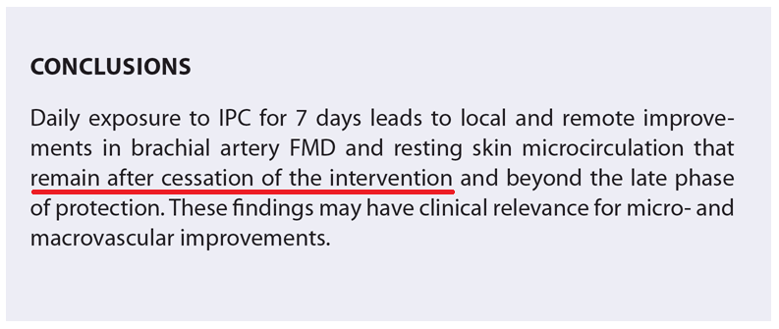

Slide 32
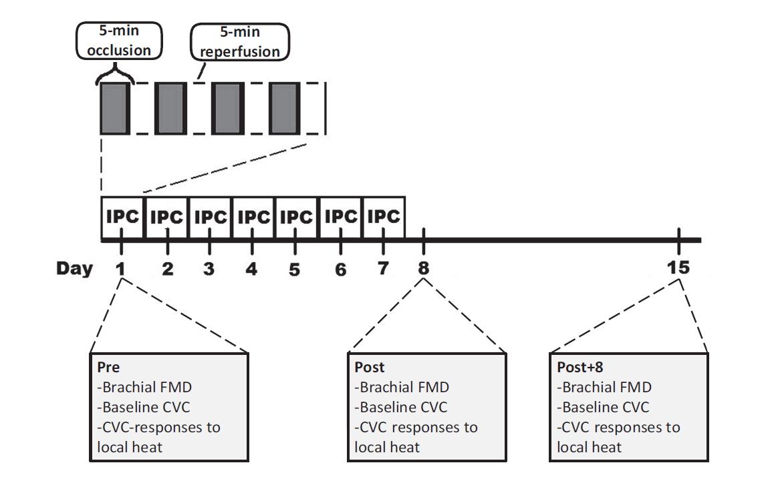

Slide 33
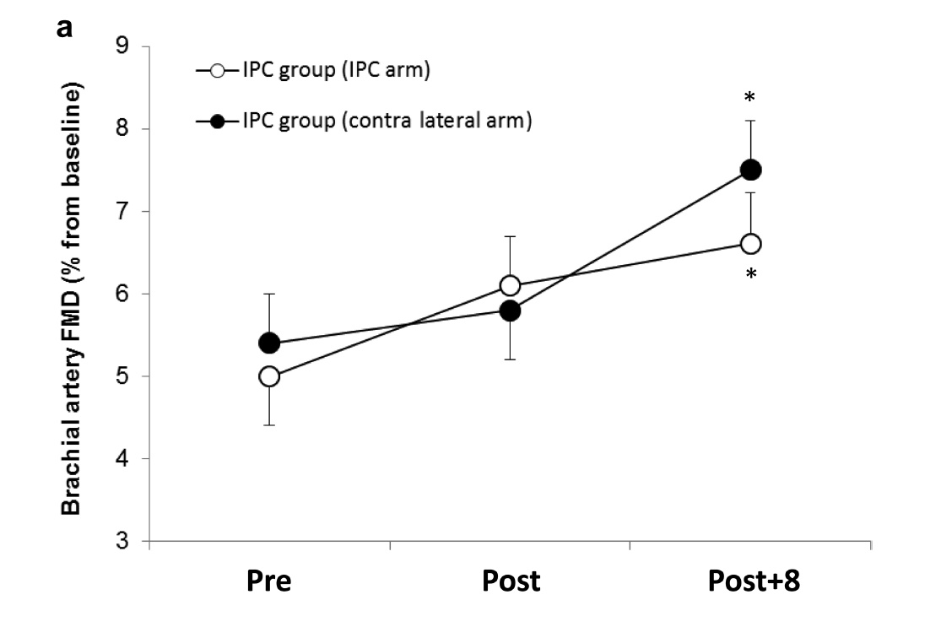

Slide 34
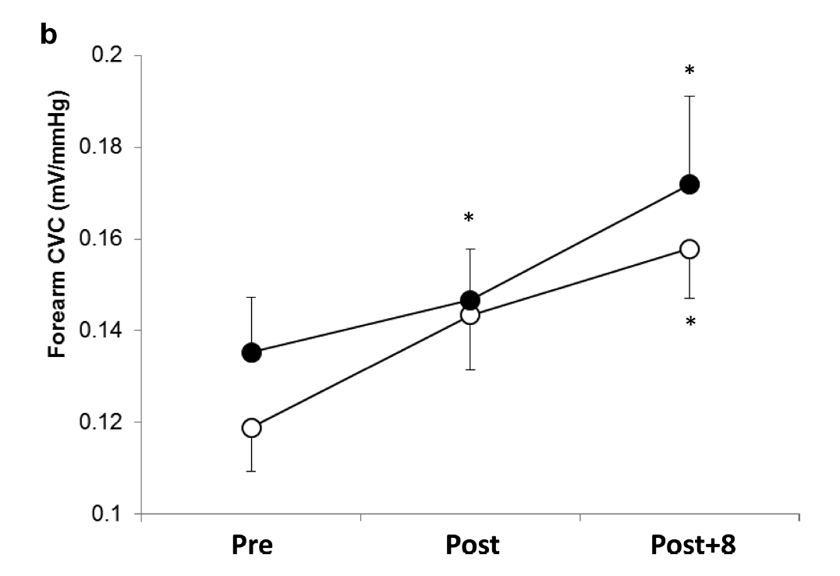

Slide 35
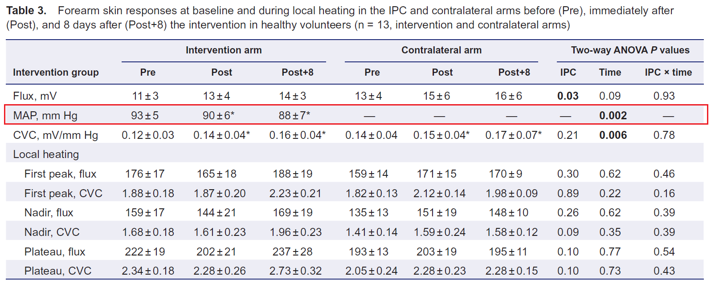

Slide 36
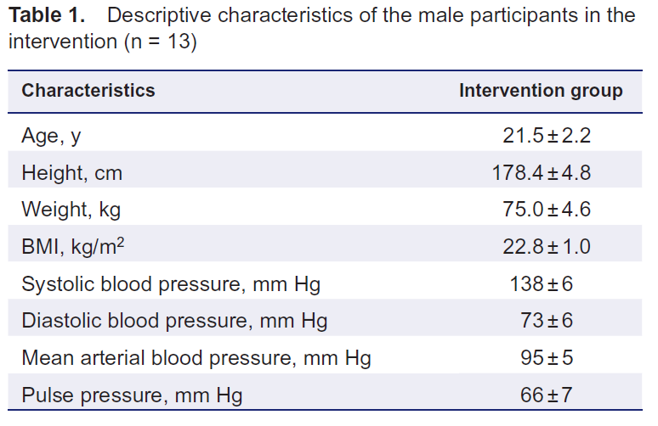

Slide 37
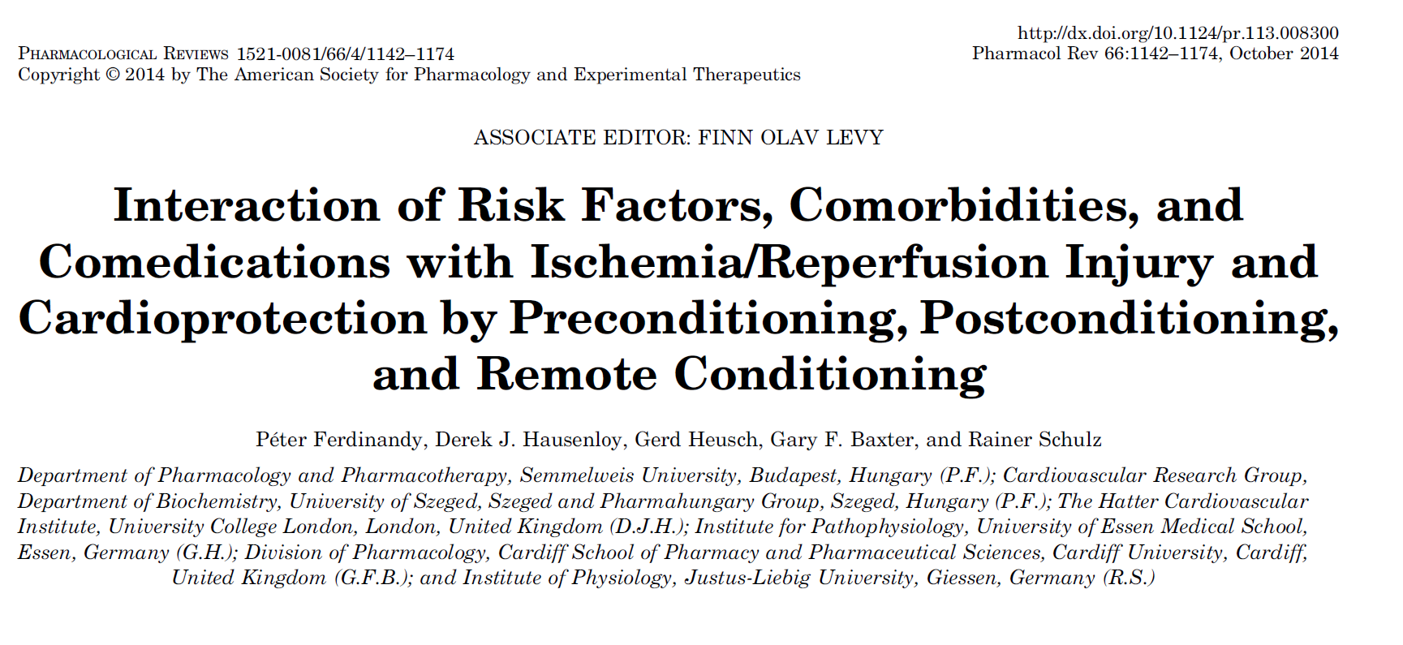
"We emphasize the critical need to take into account the presence of cardiovascular risk factors and concomitant medications when designing preclinical studies for the identification and validation of cardioprotective drug targets and clinical studies. This will hopefully maximize the success rate of developing rational approaches to effective cardioprotective therapies for the majority of patients with multiple risk factors."

Slide 38
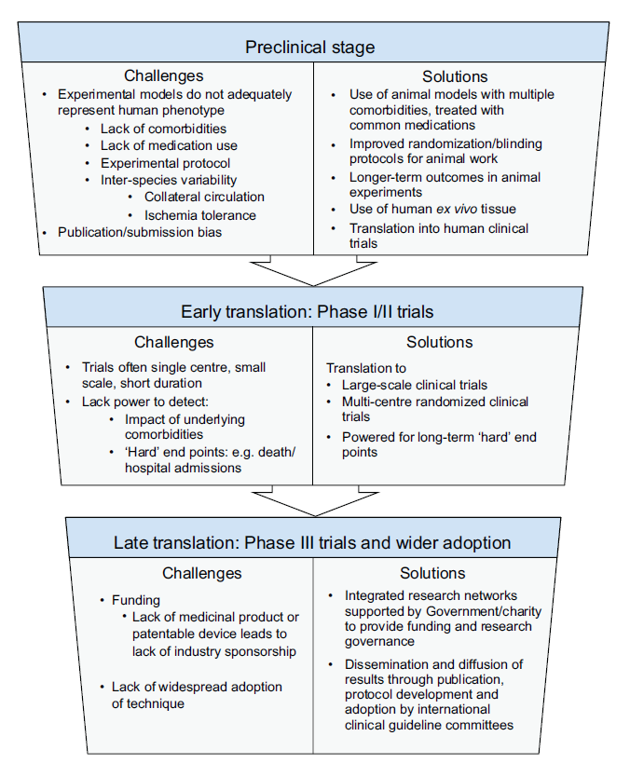
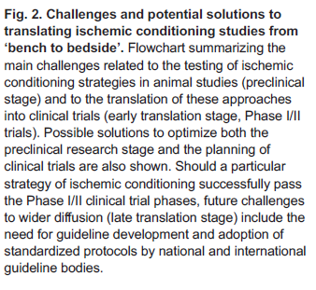
The challenge of translating ischemic conditioning from animal
models to humans: the role of comorbidities
Kieran McCafferty,§, Suzanne Forbes*, Christoph Thiemermann and Muhammad M. Yaqoob
Disease Models & Mechanisms (2014) 7, 1321-1333

Slide 39
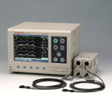
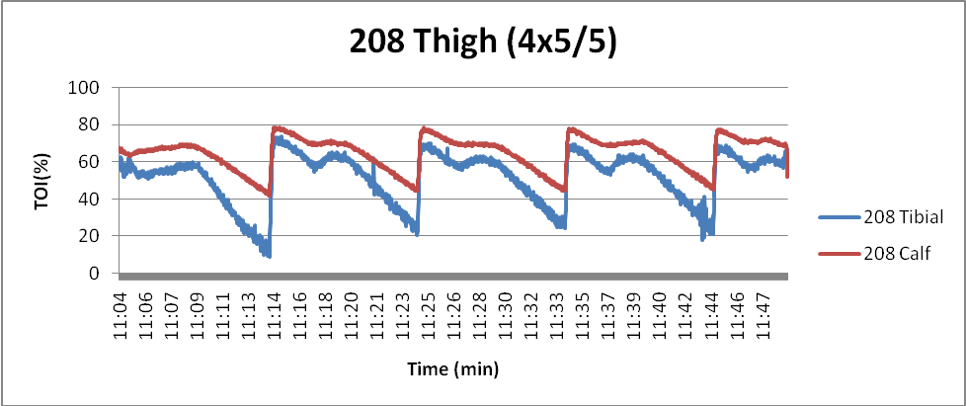
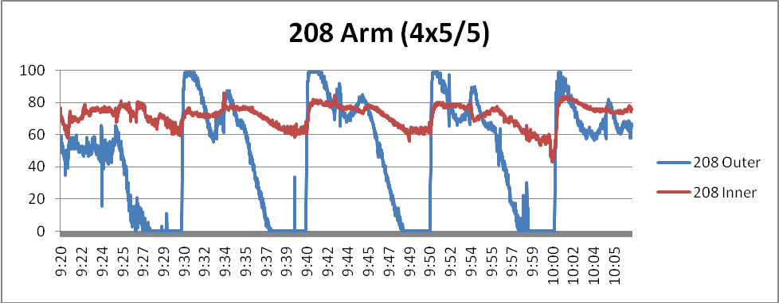
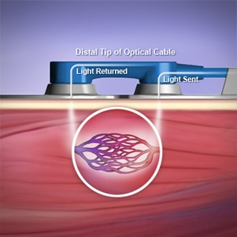
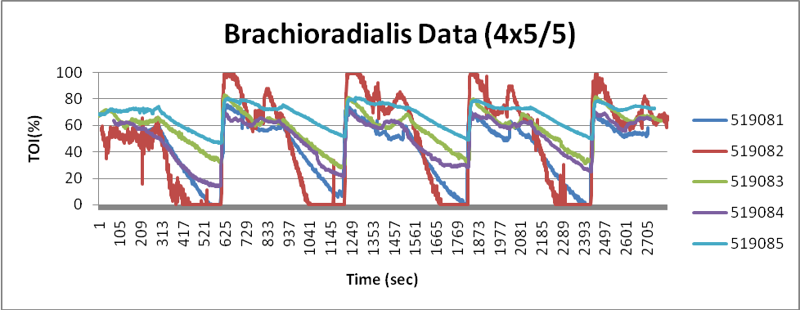
The rate of tissue deoxygenation differs between individuals.
Near-infrared Spectroscopy (NIRS)

Slide 40
The rate of tissue deoxygenation differs between individuals.

Slide 41
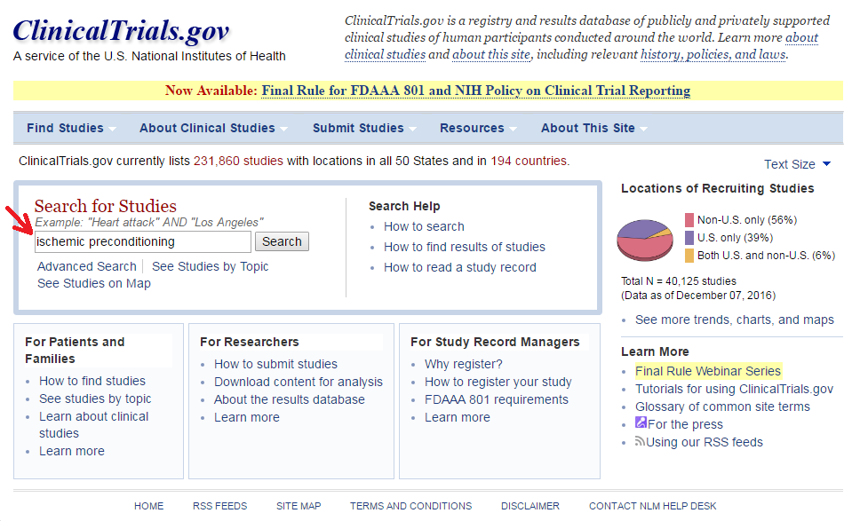

Slide 42
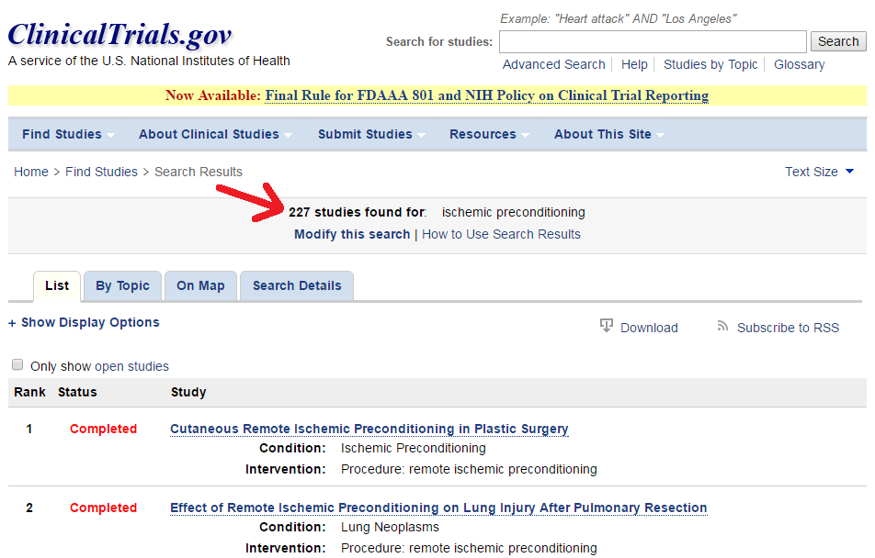

Slide 43
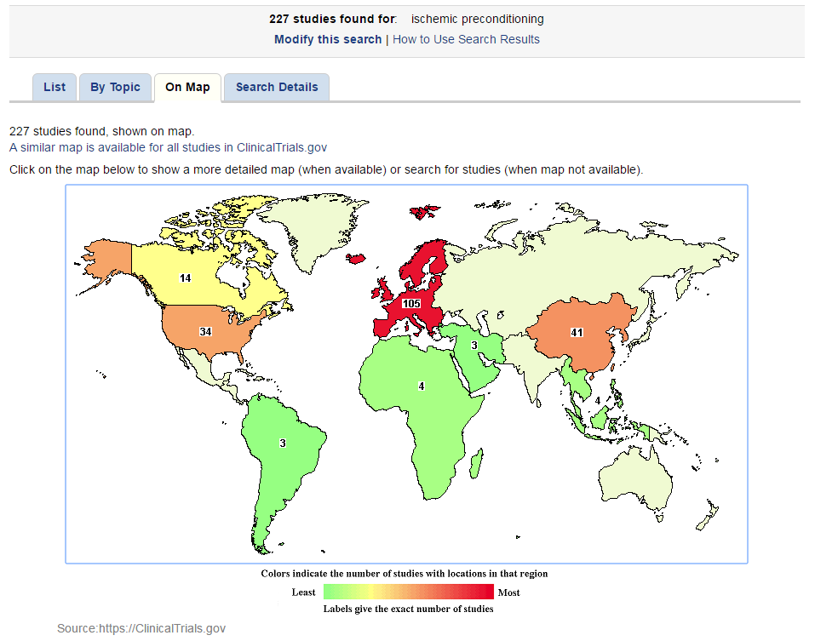

Slide 44
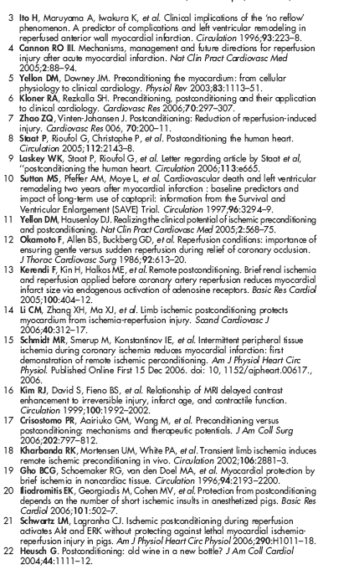
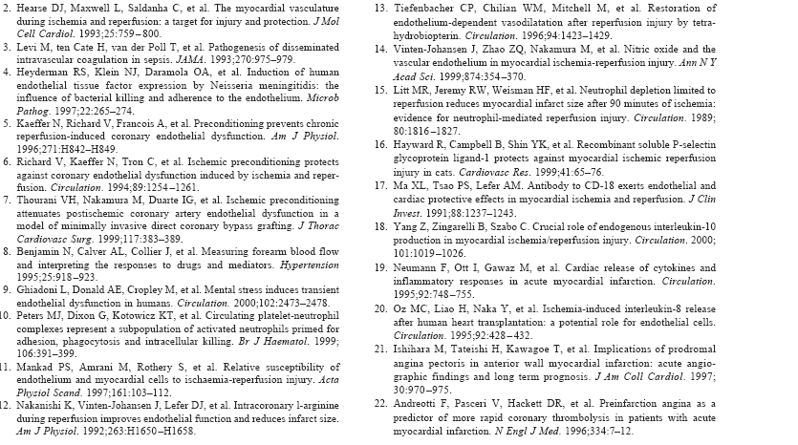
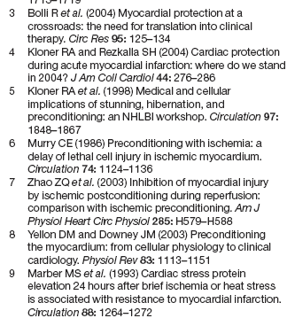
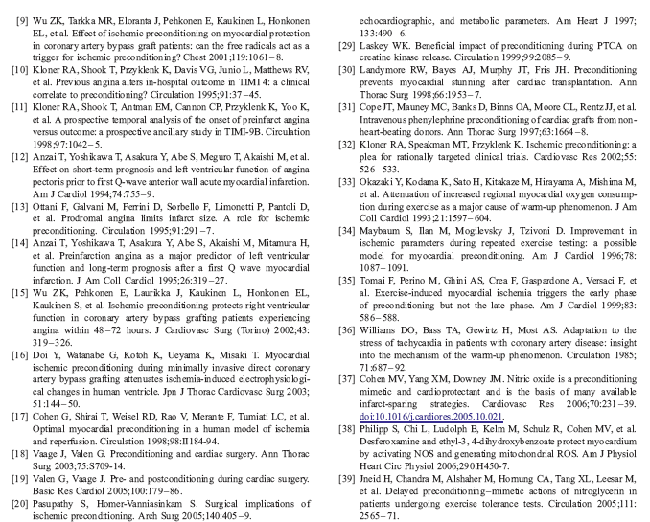
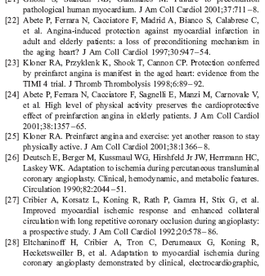
Over 4000 articles published since 1986 on Ischemic Conditioning and its potential benefits

Slide 45
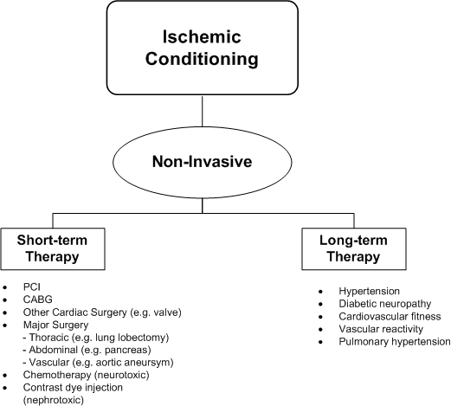
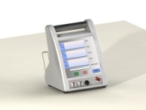
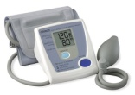

Slide 46
Replicating Physiological Cardiovascular Effects of Physical Exercise

Slide 47
Video

